Slide 1
BRITISH week2015

Slide 2
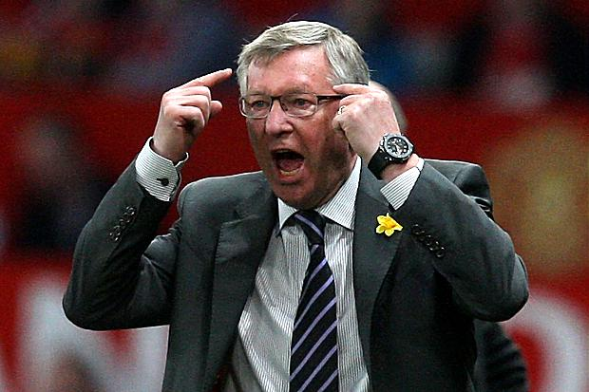
BRITISH week2015 SPORTS QUIZ
1. Who am I?
2. Which British national football team did I once manage?

Slide 3
1. SIR ALEX FERGUSON
2. SCOTLAND (NOTE THE QUESTION WAS NATIONAL TEAM)

Slide 4
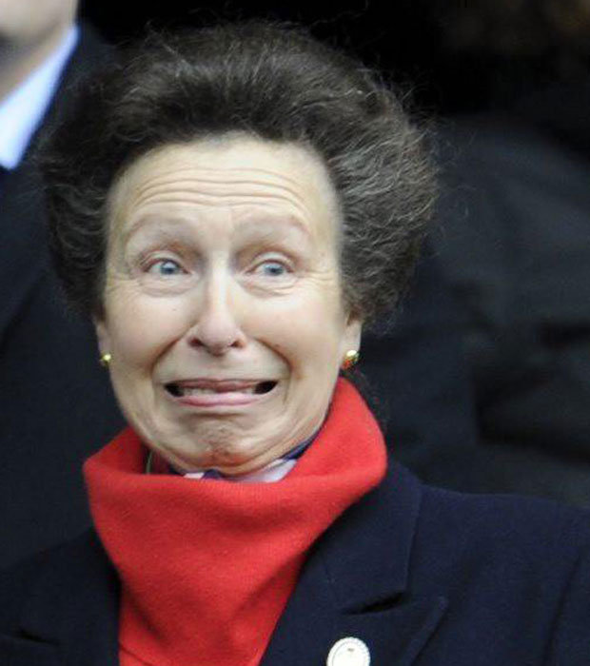
BRITISH week2015 SPORTS QUIZ
3. Who am I?
4. With which sport am I associated?
A. Horse Racing B. 3-day Eventing
C. Polo D. Show Jumping

Slide 5
3. PRINCESS ANNE
4. B (3-DAY EVENTING)

Slide 6
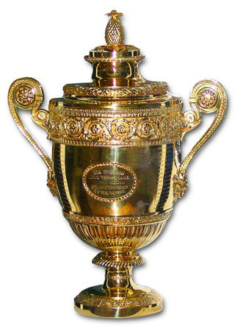
BRITISH week2015 SPORTS QUIZ
5. This trophy is played for on grass every June. What is it?
6. Who is the present holder?

Slide 7
5. WIMBLEDON MENS SINGLES TROPHY
6. NOVAK DJOCKOVIC

Slide 8
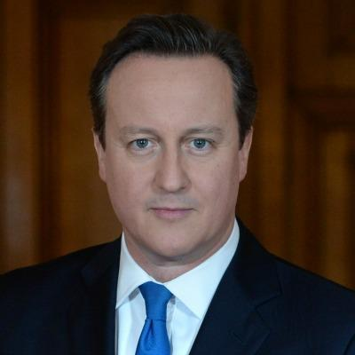
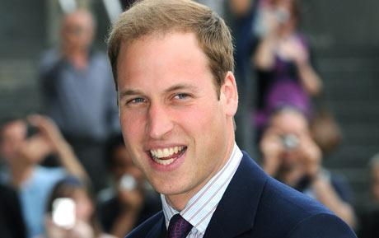
BRITISH week2015 SPORTS QUIZ
7. We think we are quite famous, but which football team do we support?
A. Aston Villa B. West Ham United C. Burnley
D. Manchester United

Slide 9
7. A ( ASTON VILLA)

Slide 10
BRITISH week2015 SPORTS QUIZ
8. This is the British Home International Football Trophy. It was played for until 1984, but who are the holders.
A. Wales
B. Northern Ireland
C. England
D. Scotland

Slide 11
8. B ( NORTHERN IRELAND)

Slide 12
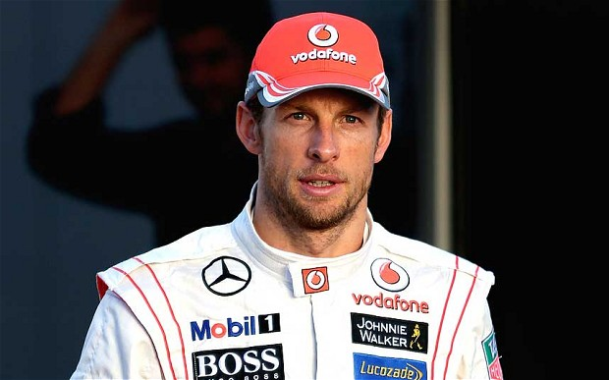
BRITISH week2015 SPORTS QUIZ
9. Who is this British Grand Prix driver and which team does he drive for?

Slide 13
9. JENSON BUTTON & McLAREN (2 POINTS)

Slide 14
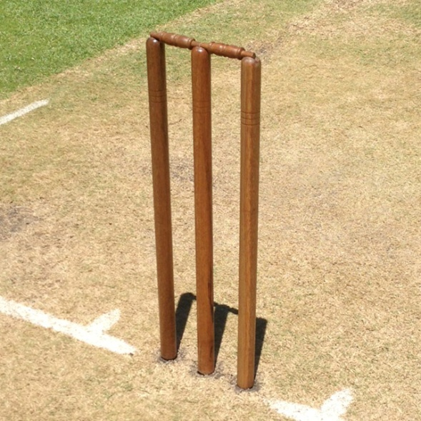
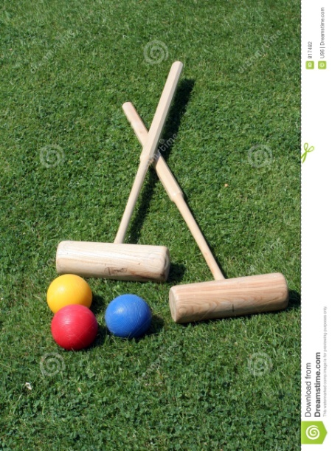
BRITISH week2015 SPORTS QUIZ
10. Which British sports are these products associated with?
A. B. C.

Slide 15
A. CRICKET,
B. CROQUET,
C. LACROSSE (3 POINTS)

Slide 16
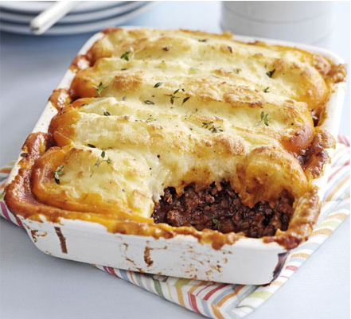
BRITISH week2015 FOOD
1. What is the typical British pie with mash potato, meat and vegetables called?
A. Cottage Pie
B. Pasta bake
C. Chicken hot pot

Slide 17
A. Cottage Pie

Slide 18
BRITISH week2015 FOOD
2. What day a week would you typically have roast beef and Yorkshire puddings with your meal?
A.Wednesday
B.Sunday
C.Thursday

Slide 19
B.Sunday

Slide 20
BRITISH week2015 FOOD
3. Which of these dishes is eaten during the summer tennis tournament Wimbledon?
A.leek and potato soup
B.strawberries and cream
C.choclate ice cream
D.cucumber sandwiches

Slide 21
B.strawberries and cream

Slide 22
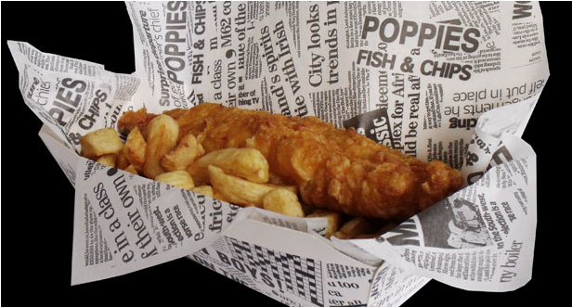
BRITISH week2015 FOOD
4.The first fish and chip shop opened in London in ... ?
A. 1650
B. 1770
C. 1800
D. 1860

Slide 23
E. 1860

Slide 24
BRITISH week2015 FOOD
5. The most common type of cheese in the UK is ..............?

Slide 25
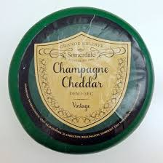
CHEDDAR

Slide 26
BRITISH week2015 FOOD
6. What does a traditional English Breakfast consist of?
A.Sausage, bacon, egg, beans, mushrooms, toast with a pot of tea
B. Sausage, bacon, egg, beans, hash browns, tomato, mushrooms, toast with a pot of tea
C. Sausage, bacon, egg, beans, tomato, mushrooms, fried bread, black pudding with a pot of tea

Slide 27
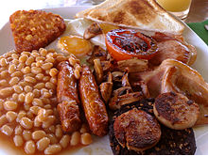
C. Sausage, bacon, egg, beans, tomato, mushrooms, fried bread, black pudding with a pot of tea.

Slide 28
BRITISH week2015 FOOD
7. Which of these is the name of a Britsh cake?
A.Plankin
B.Panik
C.Parkin
D.Pannel

Slide 29
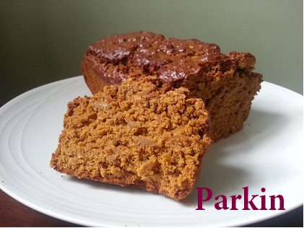
C.Parkin

Slide 30
BRITISH week2015 FOOD
8.Which of the following is not traditionally a part of a full English breakfast?
A.Bacon
B.Eggs
C.Sausages
D.Pancakes

Slide 31
D.Pancakes

Slide 32
BRITISH week2015 FOOD
9. I am a small quick bread, originally served in Scotland my popularity has now spread. I am often served with tea and cream and jam.
I am a ... ?

Slide 33
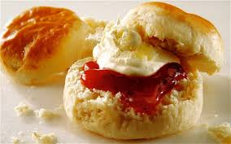
A SCONE

Slide 34
BRITISH week2015 FOOD
10.In which children's novel does the Mad Hatter's Tea Party take place?

Slide 35
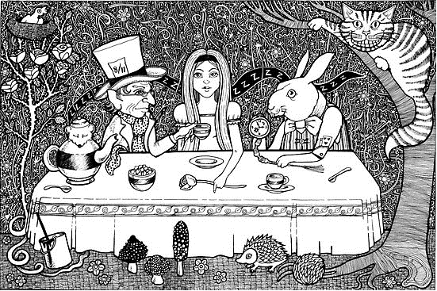
„ALICE IN WONDERLAND“

Slide 36
BRITISH week2015 ROYAL FAMILY
1.The Queen celebrates two birthdays each year. When is her actual birthday?

Slide 37
Actual 21 April

Slide 38
BRITISH week2015 ROYAL FAMILY
2. Match the names and the titles.
1. The Earl of Wessex a. Charles Philip Arthur George
2. The Duchess of Cambridge b. Anne Elizabeth Alice Louise
3. The Duke of Cambridge c. Edward Antony Richard Louis
4. The Prince of Wales d. William Arthur Philip Louis
5. The Princess Royal e. Catherine Elizabeth

Slide 39
1c
2e
3d
4a
5b

Slide 40
BRITISH week2015 ROYAL FAMILY
3.Prince William and Catherine have two children. What are their names?

Slide 41
George (Alexander Louis)
Charlotte (Elizabeth Diana)

Slide 42
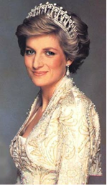
BRITISH week2015 ROYAL FAMILY
4. Who´s in the picture?

Slide 43
Princess Diana

Slide 44
BRITISH week2015 ROYAL FAMILY
5. What’s the full title of Prince Harry?
A. His Royal Highness Prince Henry of Wales
B. His Royal Highness Prince Harry of Wales
C. His Royal Highness Prince Heinrich of Wales

Slide 45
A. His Royal Highness Prince Henry of Wales

Slide 46
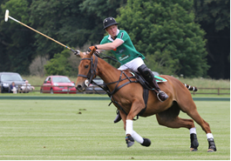
BRITISH week2015 ROYAL FAMILY
6. What’s the popular pastime with members of the Royal Family?

Slide 47
Polo

Slide 48
BRITISH week2015 ROYAL FAMILY
7. The Corgi is the animal most famously associated with The Queen. What kind of pet is it?

Slide 49
A dog

Slide 50
BRITISH week2015 ROYAL FAMILY
8.Which king is the film “King’s speech” about?

Slide 51
B. George VI

Slide 52
BRITISH week2015 ROYAL FAMILY
9. Which school did Prince William, the Duke of Cambridge graduate from?
A. The University of Oxford
B. The University of Cambridge
C. Eton College

Slide 53
C. Eton College

Slide 54
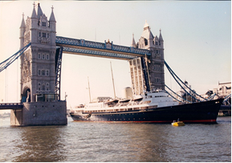
BRITISH week2015 ROYAL FAMILY
10. What’s the name of the former royal yacht of the British monarch, Queen Elizabeth II?

Slide 55
B. HMY Britannia

Slide 56
BRITISH week2015 Holidays
1. Public holidays in the United Kingdom are commonly referred to as...
A. law holidays
B. boxing holidays
C. bank holidays

Slide 57
C. bank holidays

Slide 58
BRITISH week2015 Holidays
2. Which food is associated with Shrove Tuesday?

Slide 59
Pancakes

Slide 60
BRITISH week2015 Holidays
3. Saint Patrick’s Day is held on the 17 March. Which plant is normally worn on this special day?

Slide 61
A shamrock

Slide 62
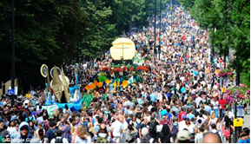
BRITISH week2015 Holidays
4. The Notting Hill Carnival is considered the world's second largest carnival. On which holiday is the carnival celebrated?
A. Early May bank holiday
B. Summer bank holiday
C. Palm Sunday
D. Ash Wednesday

Slide 63
B. Summer bank holiday

Slide 64
BRITISH week2015 Holidays
5. England's national poet, William Shakespeare is believed to be born on 23 April and also passed away on the same date at the age of 52. What anniversary of William Shakespeare was celebrated in 2014?
A. 200th anniversary of his birth
B. 350th anniversary of his birth
C. 450th anniversary of his birth

Slide 65
C. 450th anniversary of his birth

Slide 66
BRITISH week2015 Holidays
6. The Guy Fawkes Night is usually celebrated at large organised events, centred on a bonfire and extravagant firework displays. Which building did Guy Fawkes unsuccessfully try to destroy in 1605?
A. Westminster Abbey
B. Buckingham Palace
C. the Houses of Parliament

Slide 67
C. the Houses of Parliament

Slide 68
BRITISH week2015 Holidays
7. Valentine’s Day is celebrated on 14 February each year. Many people also send Valentine’s Day cards. Fill in the blanks in the famous poem.
______ are red,
Violets are _______ .
_______ is sweet,
And so are you!

Slide 69
Roses are red,
Violets are blue.
Sugar is sweet,
And so are you!

Slide 70
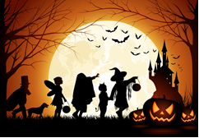
BRITISH week2015 Holidays
8. Halloween can be called in different ways, but which of the following names isn’t right?
A. Nut-crack Night.
B. Sleepy Hollow Night
C. Thump-the-door Night.
D. Apple and Candle Night.

Slide 71
B. Sleepy Hollow Night

Slide 72
BRITISH week2015 Holidays
9. The Queen's Christmas Message is a broadcast read by the monarch every year. When is it delivered to the people of the United Kingdom and the Commonwealth?
A. Christmas Day
B. Christmas Eve
C. Boxing Day

Slide 73
A. Christmas Day

Slide 74
BRITISH week2015 Holidays
10. What is Hogmanay?
A. The Welsh Christmas Day
B. The Scottish celebration of New Year
C. Good Friday in Northern Ireland

Slide 75
B. the Scottish celebration of New Year

